Slide 1
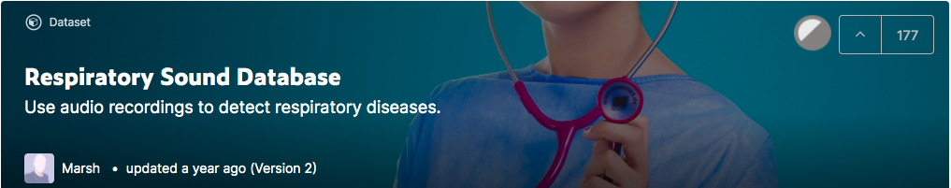
https://www.kaggle.com/vbookshelf/respiratory-sound-database

Slide 2
Context
Respiratory sounds are important indicators of respiratory health and respiratory disorders.
The sound emitted when a person breathes is directly related to air movement, changes within lung tissue and the position of secretions within the lung. A wheezing sound, for example, is a common sign that a patient has an obstructive airway disease like asthma or chronic obstructive pulmonary disease (COPD).
These sounds can be recorded using digital stethoscopes and other recording techniques. This digital data opens up the possibility of using machine learning to automatically diagnose respiratory disorders like asthma, pneumonia and bronchiolitis, to name a few.
https://www.kaggle.com/vbookshelf/respiratory-sound-database

Slide 3
Content
The Respiratory Sound Database was created by two research teams in Portugal and Greece. It includes 920 annotated recordings of varying length - 10s to 90s. These recordings were taken from 126 patients. The data includes both clean respiratory sounds as well as noisy recordings that simulate real life conditions. The patients span all age groups - children, adults and the elderly.
This Kaggle dataset includes:
920 .wav sound files
920 annotation .txt files
A text file listing the diagnosis for each patient
A text file explaining the file naming format
A text file listing 91 names (filename_differences.txt )
A text file containing demographic information for each patient
Note: filename_differences.txt is a list of files whose names were corrected after this dataset's creators found a bug in the original file naming script. It can now be ignored.
https://www.kaggle.com/vbookshelf/respiratory-sound-database

Slide 4
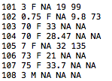
The demographic info file has 6 columns:
- Patient number
- Age
- Sex
- Adult BMI (kg/m2)
- Child Weight (kg)
- Child Height (cm)
https://www.kaggle.com/vbookshelf/respiratory-sound-database

Slide 5

Each audio file name is divided into 5 elements, separated with underscores (_).
1. Patient number (101,102,...,226)
2. Recording index
3. Chest location
a. Trachea (Tc)
b. Anterior left (Al)
c. Anterior right (Ar)
d. Posterior left (Pl)
e. Posterior right (Pr)
f. Lateral left (Ll)
g. Lateral right (Lr)
4. Acquisition mode
a. sequential/single channel (sc),
b. simultaneous/multichannel (mc)
5. Recording equipment
a. AKG C417L Microphone (AKGC417L),
b. 3M Littmann Classic II SE Stethoscope (LittC2SE),
c. 3M Litmmann 3200 Electronic Stethoscope (Litt3200),
d. WelchAllyn Meditron Master Elite Electronic Stethoscope (Meditron)
https://www.kaggle.com/vbookshelf/respiratory-sound-database

Slide 6
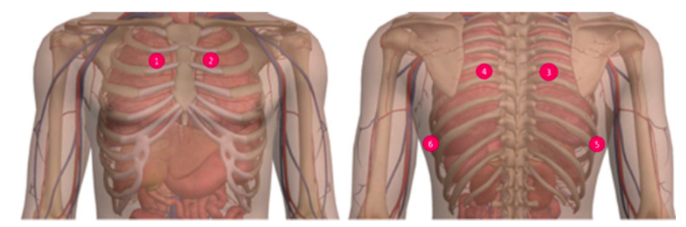
https://www.kaggle.com/vbookshelf/respiratory-sound-database

Slide 7
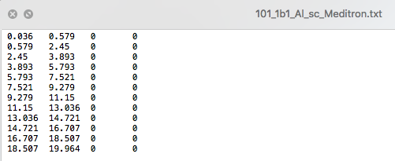
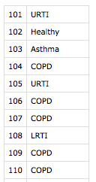
The annotation text files have four columns:
- Beginning of respiratory cycle(s)
- End of respiratory cycle(s)
- Presence/absence of crackles (presence=1, absence=0)
- Presence/absence of wheezes (presence=1, absence=0)
The abbreviations used in the diagnosis file are:
- COPD: Chronic Obstructive Pulmonary Disease
- LRTI: Lower Respiratory Tract Infection
- URTI: Upper Respiratory Tract Infection
https://www.kaggle.com/vbookshelf/respiratory-sound-database

Slide 8
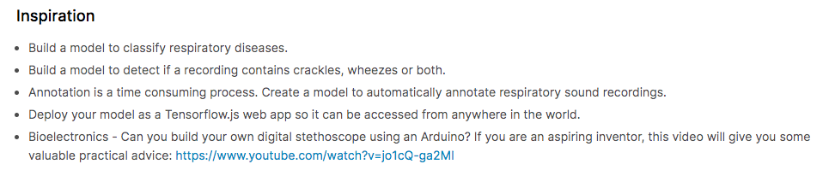
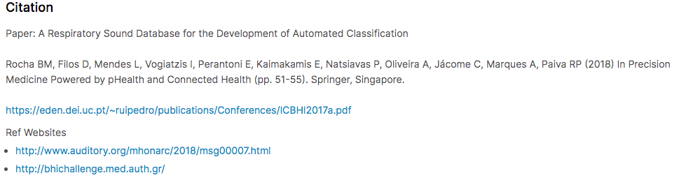
https://www.kaggle.com/vbookshelf/respiratory-sound-database

Slide 9
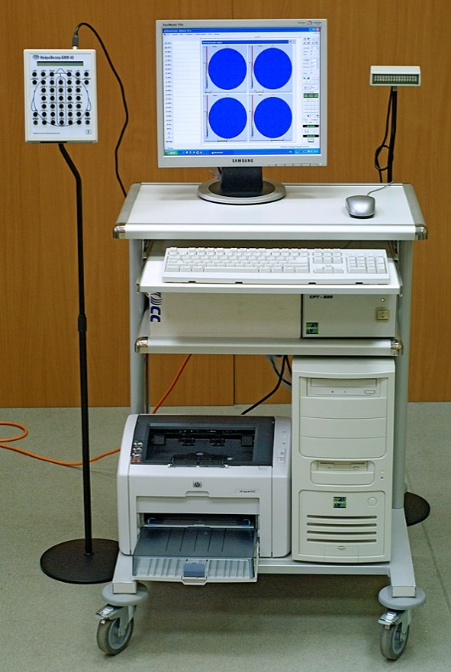
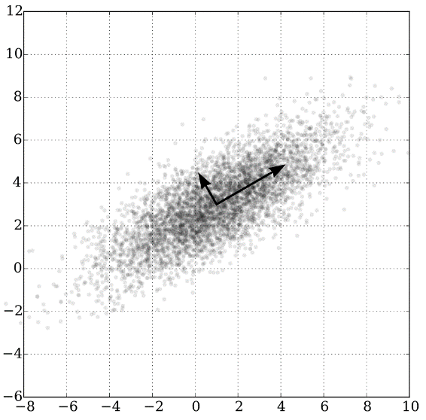
Acquisition
Manipulation
Analysis
PYTHON DATA SCIENCE FRAMEWORK
NUMPY
PANDAS
MATPLOTLIB

Slide 10


Slide 11
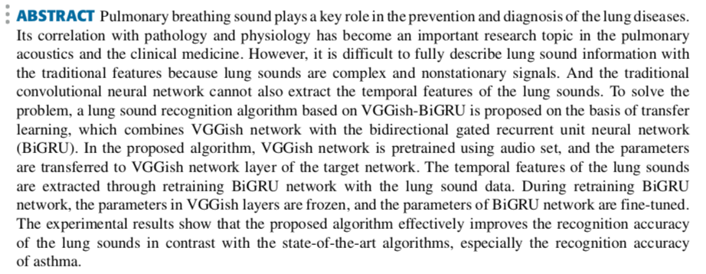

Slide 12
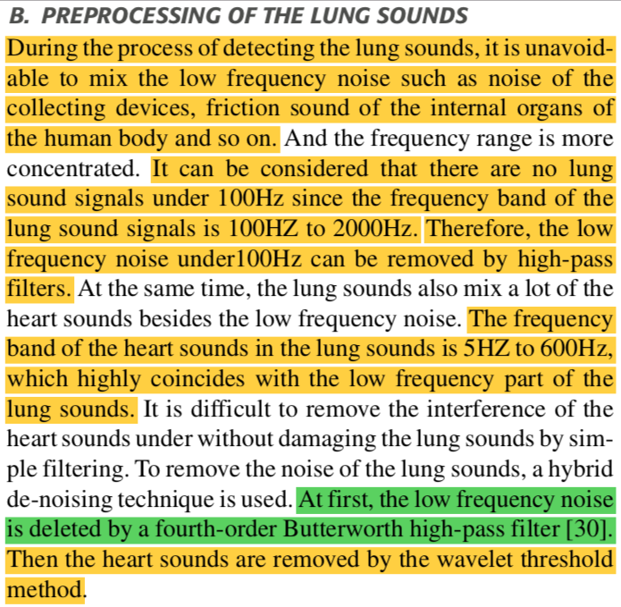

Slide 13
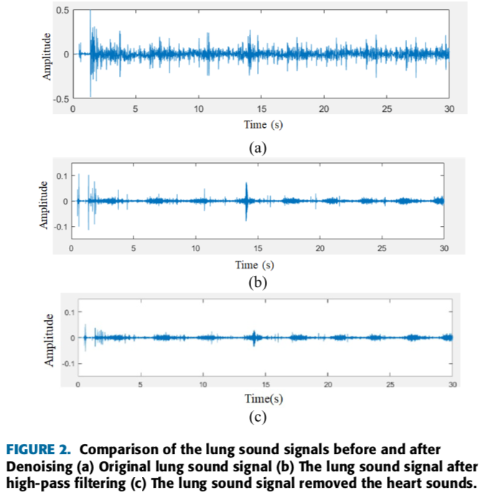

Slide 14
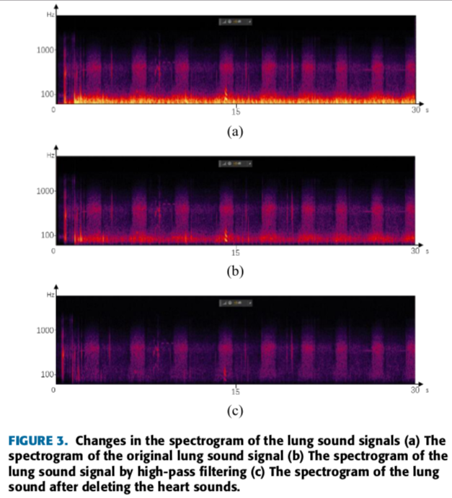

Slide 15
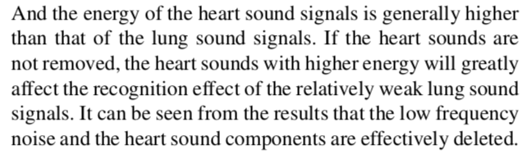

Slide 16
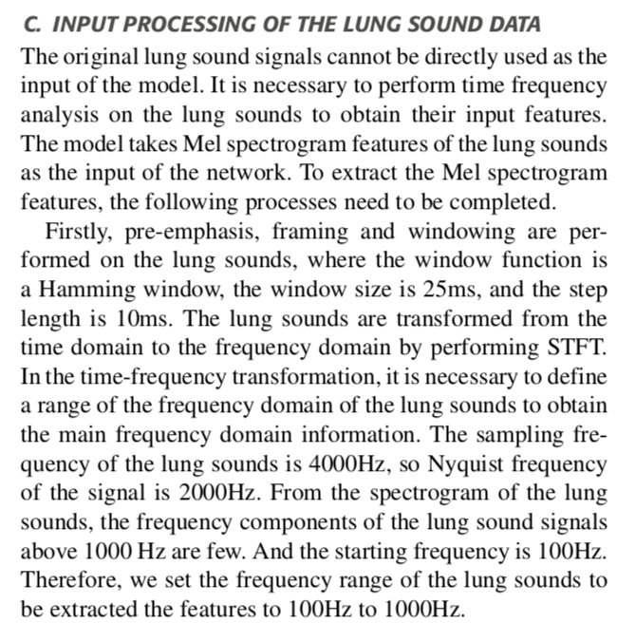

Slide 17
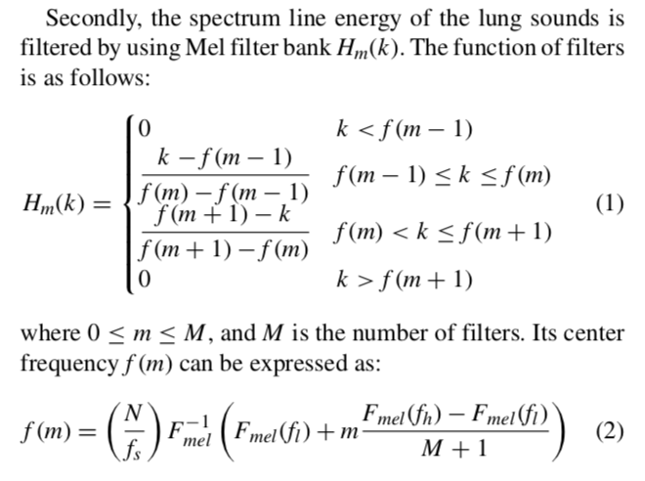

Slide 18
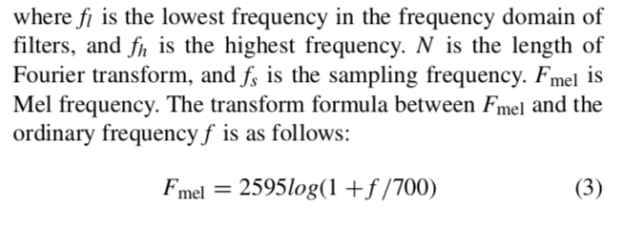

Slide 19
